Slide 1




Amazon ML Challenge Finale SPAM_LLMs
Team Member 1 <Photograph>
Team Member 2 <Photograph>
Team Member 3 <Photograph>
Team Member 4 <Photograph>
Manav Jain
Prasanth Naidu Karaka
Alok Raj
Rudraksh Sachin Joshi
IIT (ISM) Dhanbad
IIT (ISM) Dhanbad
IIT (ISM) Dhanbad
IIT (ISM) Dhanbad

Slide 2
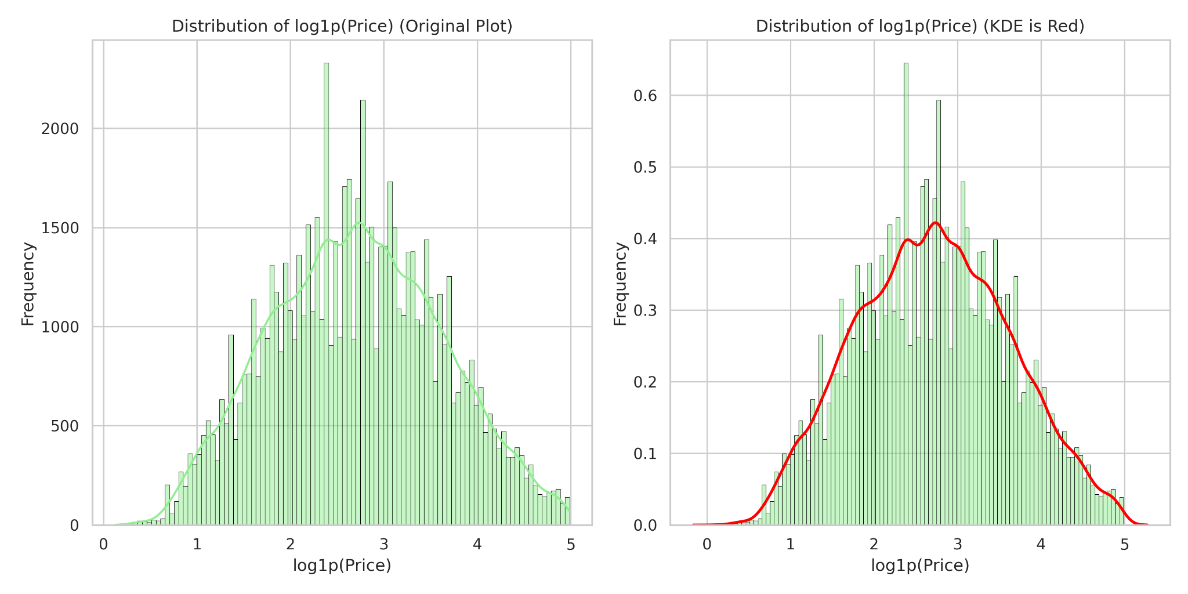
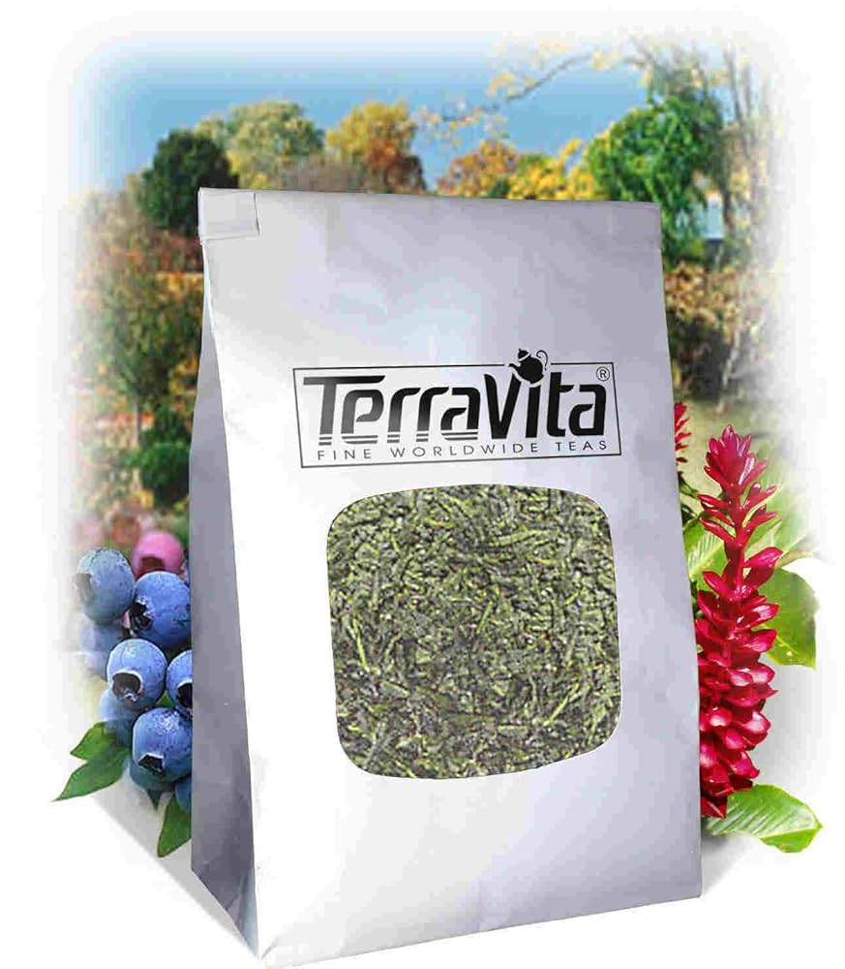
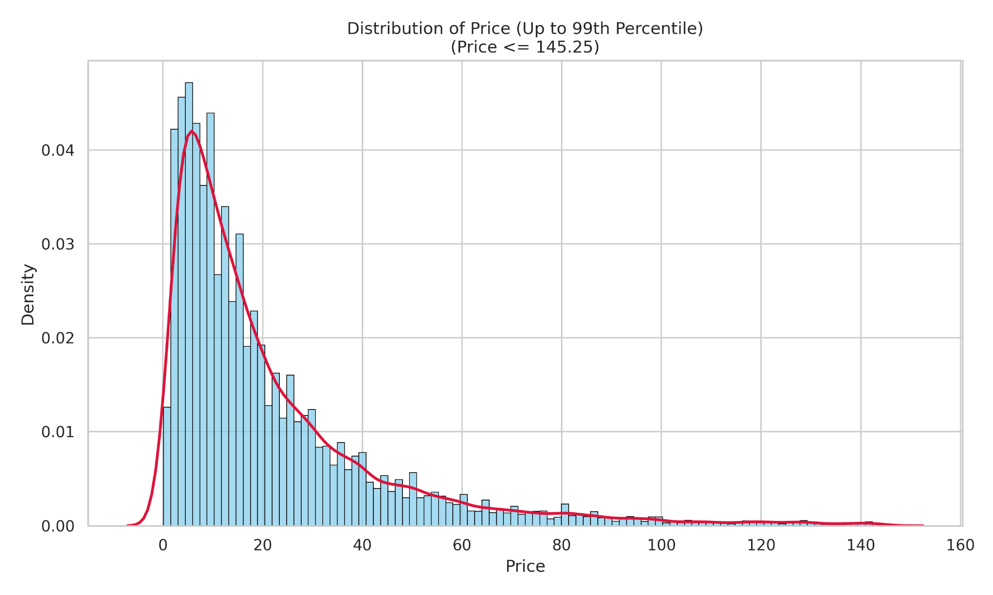
Qualitative & Quantitative Data Analysis
Distribution
Data Variance
Pre-Processing
Frequency Distribution of Raw Price (0-99th Percentile)
Frequency Distribution of Log Transformed Price (0-99th Percentile)
Visual Duplication Variance:
- Catalog Content Strip: Product Description, Bullet Points, Unit, Value
- Textual Preprocessing: Emoji removal, numbers to text conversion.
- Unit Mapping Standardization: gram, gm, grams -> gm; case removal, grouping
- Unknown Units: Mapped to NA (Others)
- Prioritization: Product Description or top 5 bullet points
- Training Data Handling: Empty value processing, log normalization of price, label encoding of units
Price 1 : 39.41$
Price 2 : 29.07$
+
Varied catalogs
Textual Duplication Variance:
PAPYRUS Everyday Card
Repeated Instances (Train) : 21
Min price : 9.97$
Max price : 20.495$
Mean price : 16$
Original Price Data (Up to the 99th Percentile)
Number of Values: 74,250
Mean: 21.63
Variance: 511.07
Original Price Data (Beyond the 99th Percentile)
Number of Values: 750
Mean: 223.04
Variance: 20,672.09
Log-Transformed Price Data (Up to the 99th Percentile)
Number of Values: 74,250
Mean (log1p(Price)): 2.71
Variance: 0.83
Log-Transformed Price Data (Beyond the 99th Percentile)
Number of Values: 750
Mean (log1p(Price)): 5.33
Variance: 0.12
Severe positive skew → Applied log1p transform + normalization
Ideation
Use Image Features, Text Features, Fused Image-Text Features, and Processed Tabular Data for training & indexing (MLPs, KNNs, LGBMs, Transformers)

Slide 3

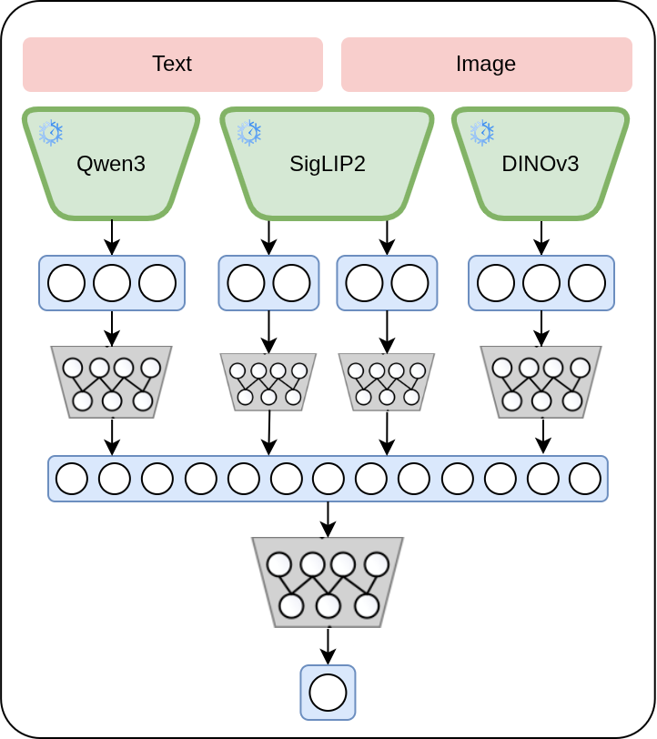
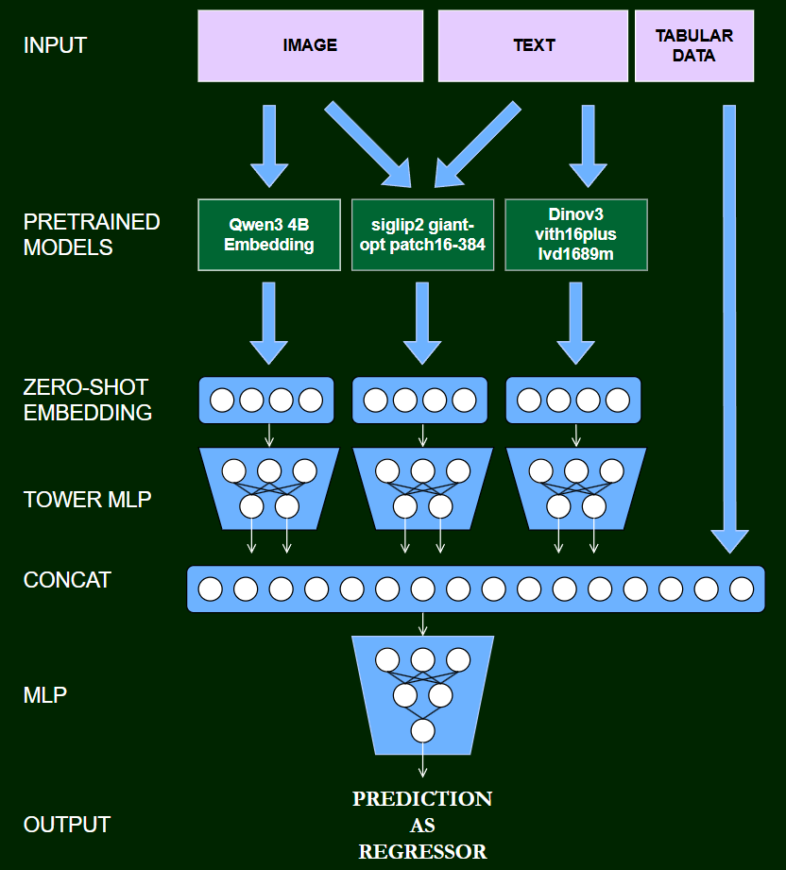
Our Model : Architecture & Loss
Architecture
Loss Function
Latency
Embedding Generation:- 84 ms/sample
MLP head:- 30 µs/sample
*Benchmarked on P100 GPU
Concept
Input Towers: Each of the 4 embedding types (Image, Text, Text+Image) is processed by its own feed-forward tower (Linear → ReLU → BatchNorm → Dropout).
Purpose: Towers project high-dimensional embeddings into a shared 512-dimensional space, learning relevant features from each modality.
Fusion: Outputs of all 4 towers are concatenated into a 2048-dimensional unified feature vector.
Regression Head: The fused vector is passed through an MLP to predict the final price.
Advantage: Allows learning of specialized compact representations per modality before combining them for the final prediction.
Parameters
Text – 4B, Image – 0.8B, Text+Image – 2B, MLP – 8.9M x 5 (5-Fold)

Slide 4


Previous Approaches
Tree-Based Models: LGBM and Beyond
KNN-Based Feature Extraction
Parsed catalog content to extract meaningful features.
Incorporated previously generated embeddings alongside the new features.
Applied regression models combining features and embeddings.
Approach with combined features and embeddings was unsuccessful.
Used FAISS-based KNN for finding nearest neighbors of embeddings.
Applied to enhance feature representation with similar embeddings.
Due to small-scale dataset, performance did not meet expectations.
Cross-Attention Integration
MinMax + Log Loss
Planned to replace separate networks with cross-attention between modalities.
Aimed to improve performance by integrating information across modalities.
The approach did not yield the expected improvements in performance. Needs further experimentation.
Applied MinMax scaling to targets (0,1) and used BCE Loss to improve SMAPE metric

Slide 5

Expansion & Future Work
Embeddings Expansion into KNN
Cross Attention & BCE-Loss
Post-model correction using nearest neighbors in embedding space.
Each item uses its embedding and predicted price; the model refines prediction based on local neighbor residuals.
Mechanism:
- Find k nearest neighbors within a price band x.
- Compute a weighted residual Δ from those neighbors.
- Adjust the predicted price by α·Δ.
Controls: k, x, λ, α → locality / tolerance / decay strength.
Smooths inconsistencies, improves calibration in sparse regions.
Refine cross-attention integration to improve information sharing across modalities.
Enhance MinMax + BCE loss formulation for better SMAPE stability.
Explore hybrid loss functions to improve convergence.
Conduct further experiments to evaluate performance across diverse modalities.
Hyperparam. tuning & Arch. Search
Richer embedding models, different configs of MLP head to be explored, like adapter depth, adapter dim., etc.

Slide 6
THANK YOU !!
Team SPAM_LLMs

